Slide 1
How to Use This Template
Follow the instructions in the course to create this presentation.
Note that you will be saving this presentation as a PDF. Therefore, all the content will be on the face of the slide. Content in the notes section will not be published.
Don’t use animation as it won’t reflect in the PDF.
Add as many additional slides as you need.
Feel free to add pictures and anything that you need to enhance the presentation.

Slide 2

Business Intelligence Analysis

Slide 3

Table of Contents
Introduction
Methodology
Results
Discussion
Conclusion
Appendix
Stock ID: 47857043

Slide 4

Introduction

Slide 5

Introduction
Background Information
The retail chain operates a network of stores across multiple cities, offering a diverse range of products. With growing competition and fluctuating market demands, the company seeks to enhance its sales performance and optimize stock levels.
Objective of the Analysis
This analysis aims to:
Identify Sales Trends: Understand how sales evolve over time and across locations.
Analyze Stock Impact: Determine how stock availability influences sales volume.
Conduct Regression Analysis: Assess the relationship between sales and time to forecast future trends.
Provide Data-Driven Recommendations: Suggest actionable insights to improve inventory management and maximize revenue.

Slide 6

Methodology

Slide 7
Data Details
The data consists of 6 .csv files, the main one regarding sales and transactions and the other 5 being auxiliary regarding details about products, stores and locations.

Slide 8
Module 1: Data Cleaning and Preparation Using Excel
Imported raw sales data into Excel.
Used filters, sorting, and conditional formatting to identify missing or inconsistent values.
Applied Excel formulas to clean and format the dataset.
Standardized column headers and removed duplicates to ensure integrity.

Slide 9
Module 2: Data Querying and Analysis Using PostgreSQL
Data Querying:
Utilize SQL queries to extract and manipulate data from the PostgreSQL database
Perform checks to ensure data is populated in the tables.
Data Analysis:
Create data cubes using the ROLLUP function to summarize data along hierarchies.
Analyze sales trends over time and across various regions to identify patterns.
Results:
Interpret the results of the SQL queries to derive insights that inform business strategies.

Slide 10
Module 3: Data Visualization and Statistical Analysis
Used Python (Plotly, Pandas, and Seaborn) for advanced visualizations.
Created a Sunburst Chart to analyze sales distribution across cities, stores, and products.
Developed a scatter plot with a trendline to study the relationship between stock levels and sales volume.
Conducted regression analysis in Excel to evaluate how sales change over time.

Slide 11
Module 4: Data Visualization and Dashboards Using Tableau
Imported processed data into Tableau.
Created a dashboard showcasing sales performance, stock trends, and key insights.
Designed interactive charts to allow dynamic filtering by store, product, and time period.
Provided a data-driven recommendation section for business decision-making.

Slide 12
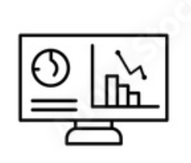
Results

Slide 13
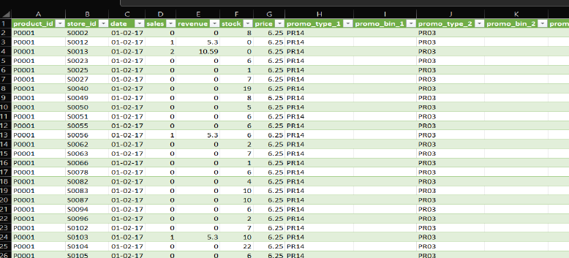
Module 1, Lesson 1: Data Cleaning and Preparation

Slide 14
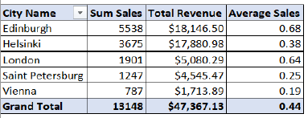
Module 1, Lesson 2: Data Analysis Using Pivot Tables

Slide 15
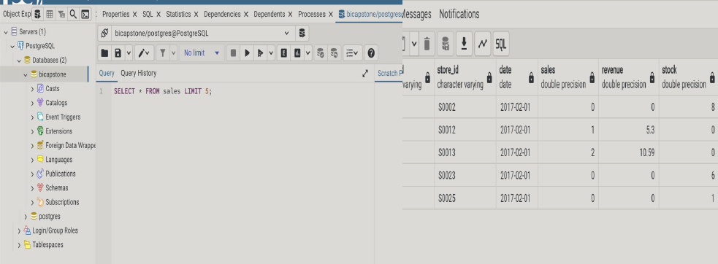
Module 2, Lesson 1: Data Querying Using PostgreSQL

Slide 16
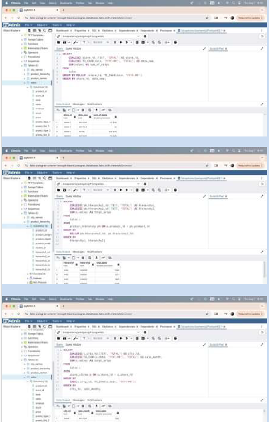
Module 2, Lesson 2: Data Analysis Using PostgreSQL
Creation of Data Cubes with ROLLUP: This helps in identifying which products perform best in specific regions or time periods, allowing businesses to tailor their sales strategies and inventory levels accordingly.
Summarizing Data Along Hierarchies: This enables businesses to focus on high-performing categories while identifying underperforming areas that may need attention or strategic changes, thus optimizing marketing efforts and resource allocation.
Identifying Sales Trends Over Time and Across Various Regions: This information is crucial for forecasting demand, planning promotions, and managing stock levels effectively to avoid overstocking or stockouts, ultimately leading to improved customer satisfaction and profitability.

Slide 17
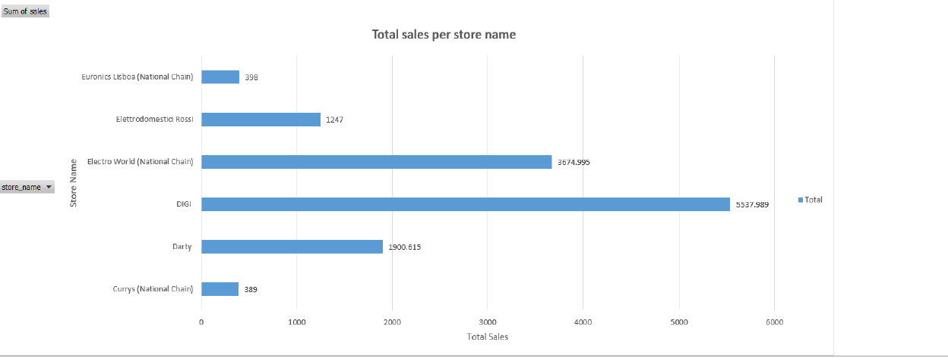
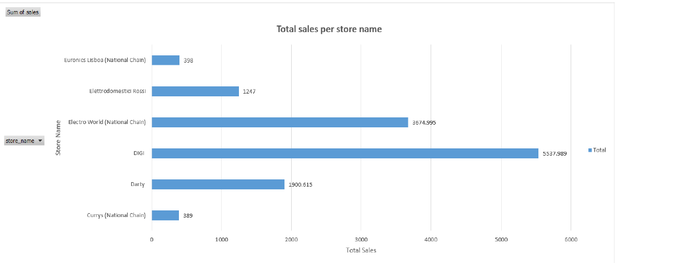
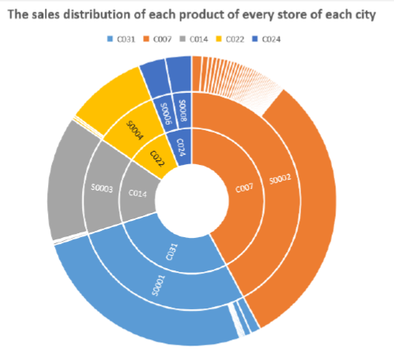
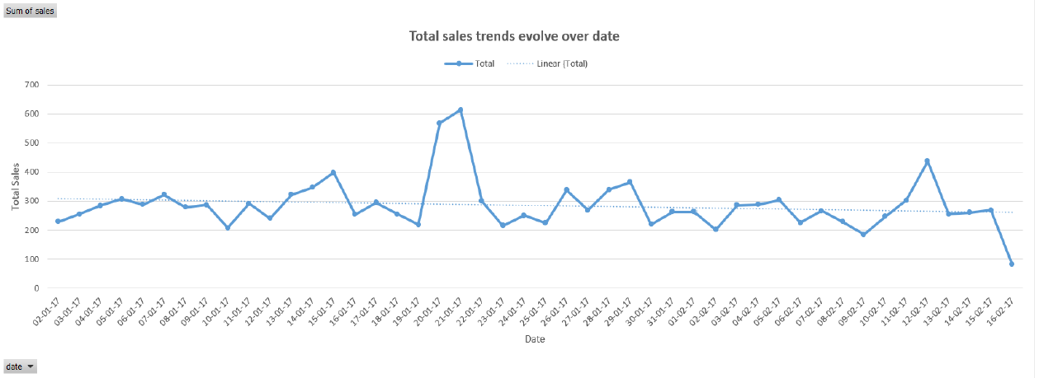
Module 3, Lesson 1: Data Visualization Using Excel

Slide 18
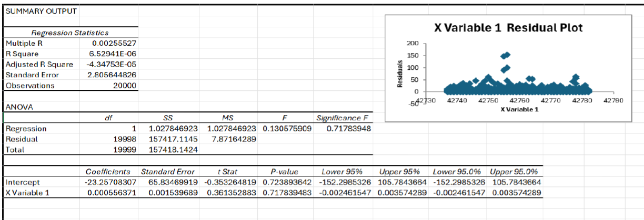
Module 3, Lesson 2: Statistical Analysis

Slide 19
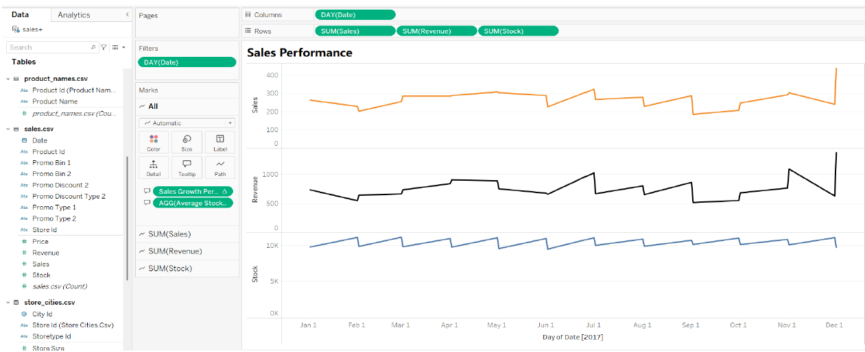
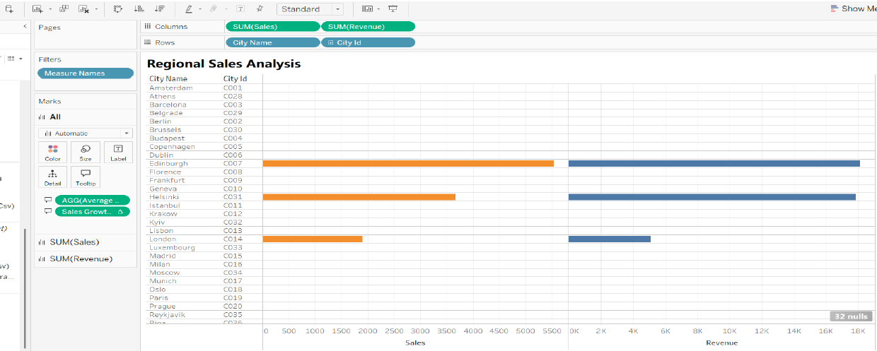
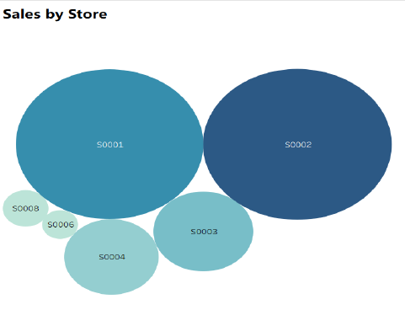
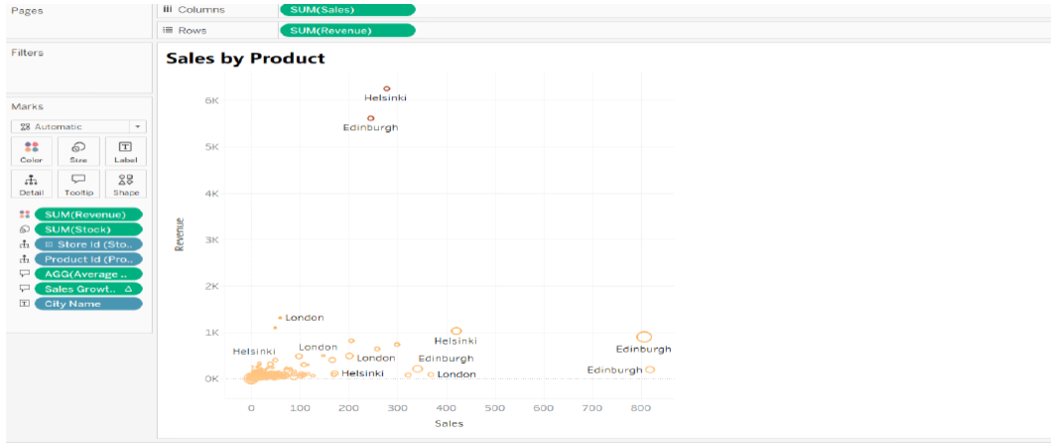
Module 4, Lesson 1: Basic Tableau Visualizations

Slide 20
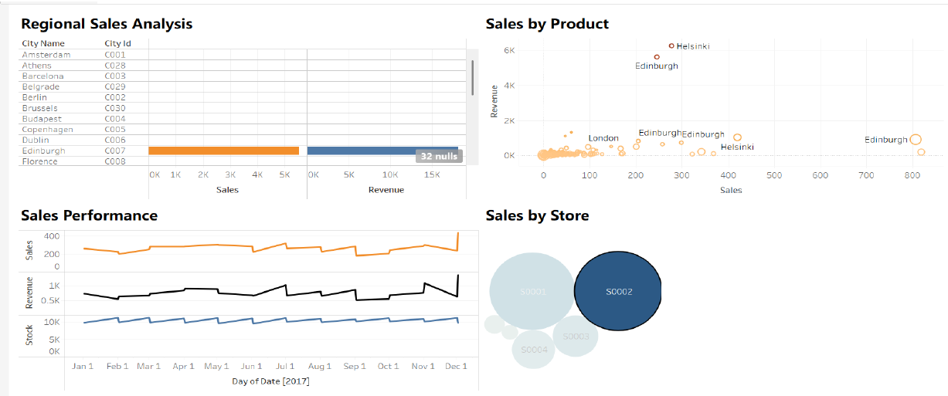
Module 4, Lesson 2: Advanced Visualizations Using Tableau

Slide 21

Discussion

Slide 22
Insights and Recommendations
Sales Performance Varies by Location
Some stores significantly outperform others, indicating differences in customer demand and purchasing behavior.
Implication: The retail chain should analyze store-level factors (e.g., location demographics, competitor presence) to optimize operations.
Stock Levels & Sales Correlation is Weak
The scatter plot and regression analysis suggest no strong correlation between stock levels and sales.
Implication: Other factors (such as pricing, promotions, and seasonality) might have a greater influence on sales trends.
Regression Analysis Shows No Strong Predictive Relationship
The R² value is nearly zero, indicating that the independent variable does not significantly predict sales.
Implication: Businesses should consider more variables (e.g., marketing campaigns, discounts, seasonal trends) in future predictive models.

Slide 23

Conclusion

Slide 24
Summary
Analysis of Sales Performance Across Cities
Based on the provided key findings, here is a rewritten summary and conclusion, emphasizing clarity and actionable insights.
Key Findings
The analysis reveals distinct performance patterns across different cities:
Helsinki and Edinburghshow strong revenue despite moderate sales volumes. This suggests that these locations are either sellinghigh-value productsor have adopted successfulpremium pricing strategies.
In contrast,London and Saint Petersburggenerate lower revenue relative to their high sales volume. This indicates a potential reliance onlower-priced productsor smaller transaction values.
Stock managementappears to be a key area for improvement. Some cities maintain high stock levels without a corresponding increase in revenue, which points to potential inefficiencies in inventory and logistics.
Conclusion and Recommendations
The company's strategy should focus on two primary areas for optimization:
Pricing Strategy: Review and adjust the pricing model in cities likeLondon and Saint Petersburgto increase revenue without compromising sales volume. The success of Helsinki and Edinburgh can serve as a benchmark for this effort.
Stock Management: Improve inventory allocation by linkingstock levels to revenue potential. This will help prevent overstocking in low-revenue cities and ensure that high-revenue locations have adequate supply to meet demand.

Slide 25

Appendix

Slide 26
Appendix #
Include any relevant additional charts, worksheets, or tables that you may have created during the analysis phase

